Slide 1

System Models and Dynamical Response
23AID201
Lecture 4
Dr. Mrittunjoy Guha Majumdar
School of Artificial Intelligence, Amrita Vishwavidyapeetham Delhi NCR

Slide 2
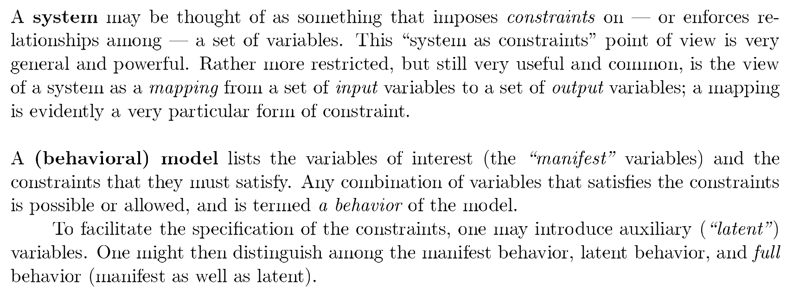
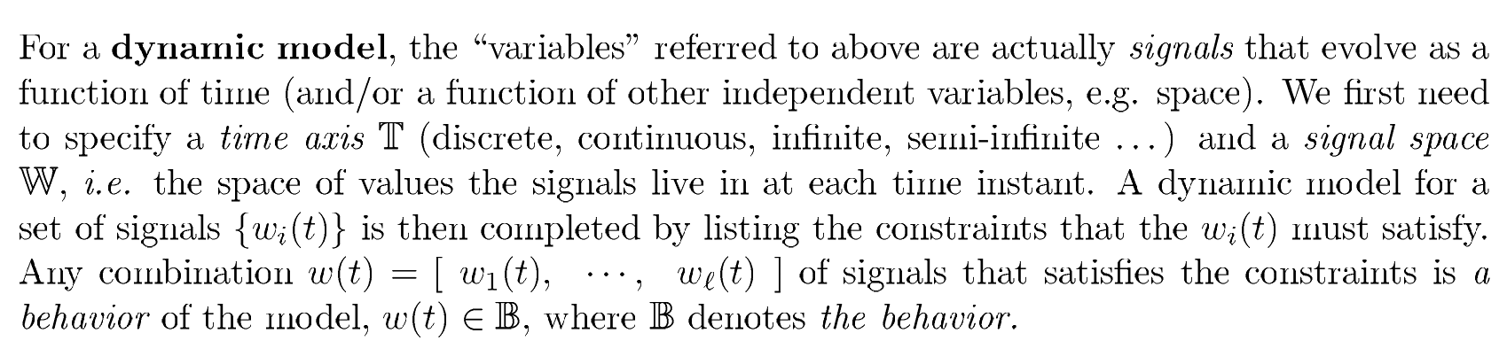

Slide 3
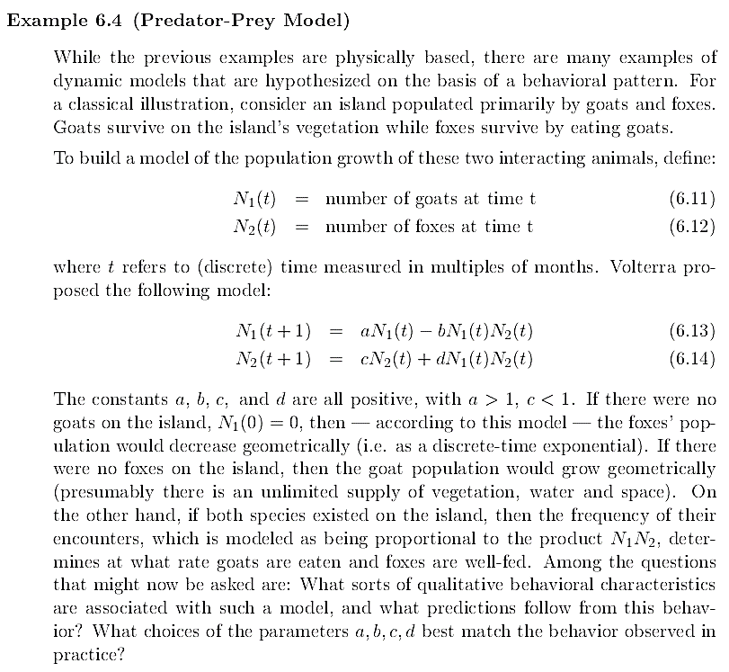

Slide 4
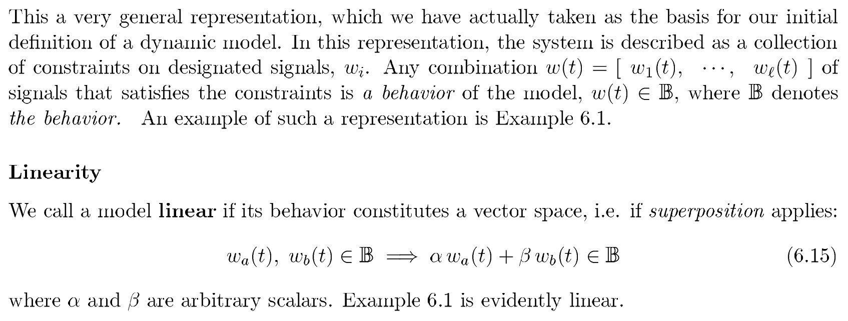
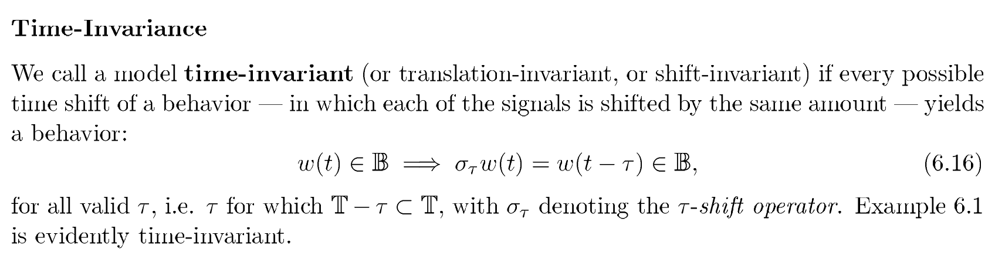
Behavioural Models

Slide 5
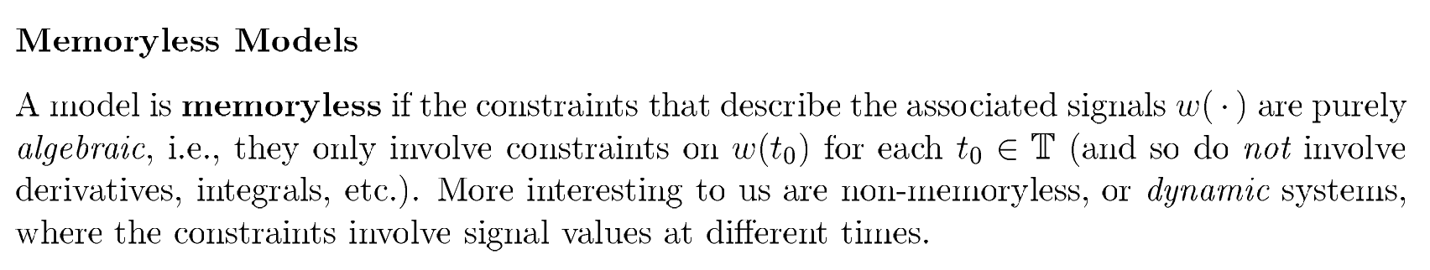

Slide 6
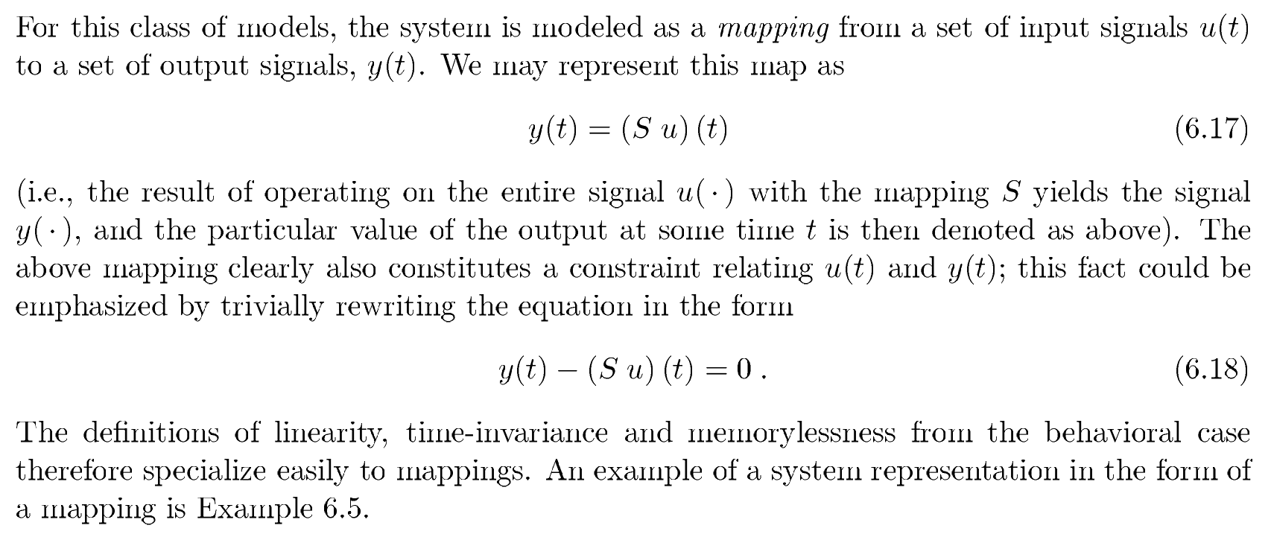
Input-Output Models

Slide 7
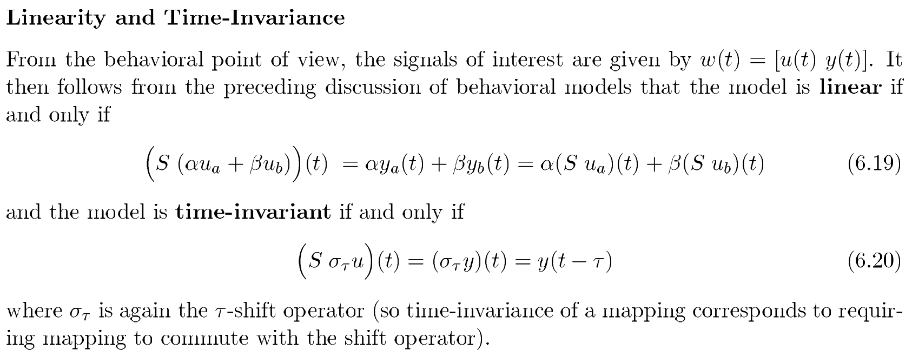
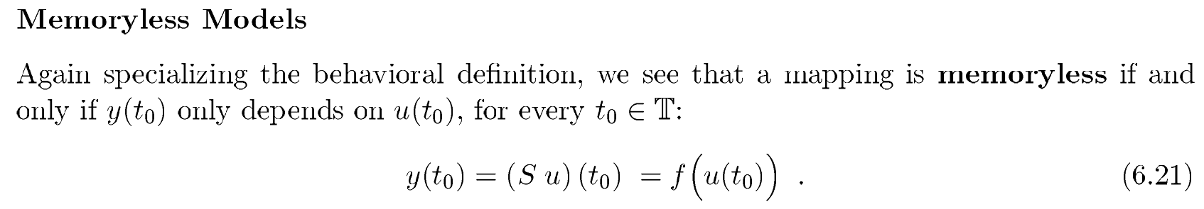

Slide 8
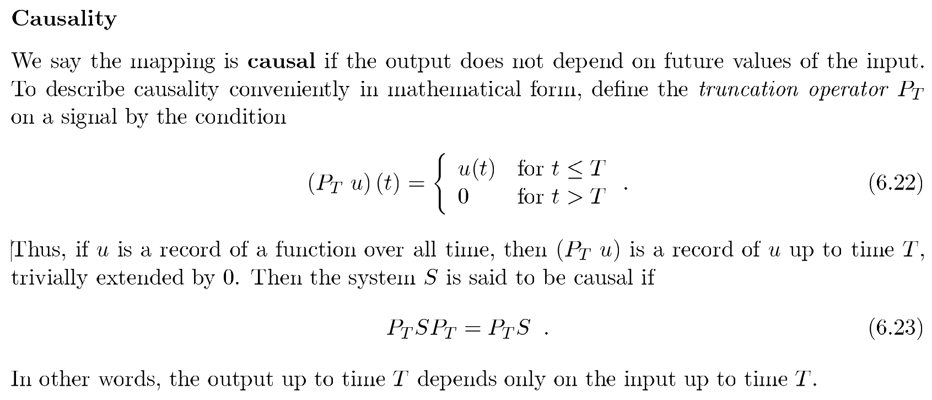

Slide 9
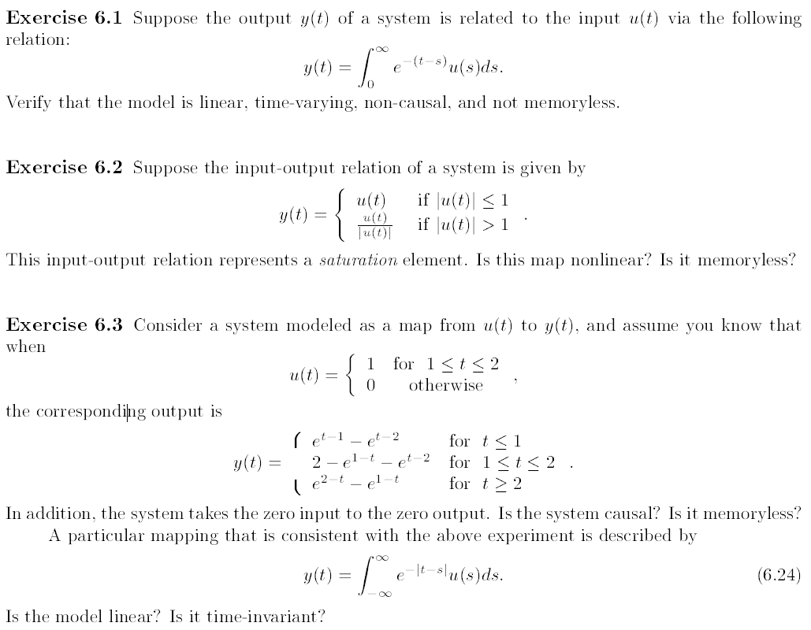
Exercise 1.
Exercise 2.
Exercise 3.

Slide 10
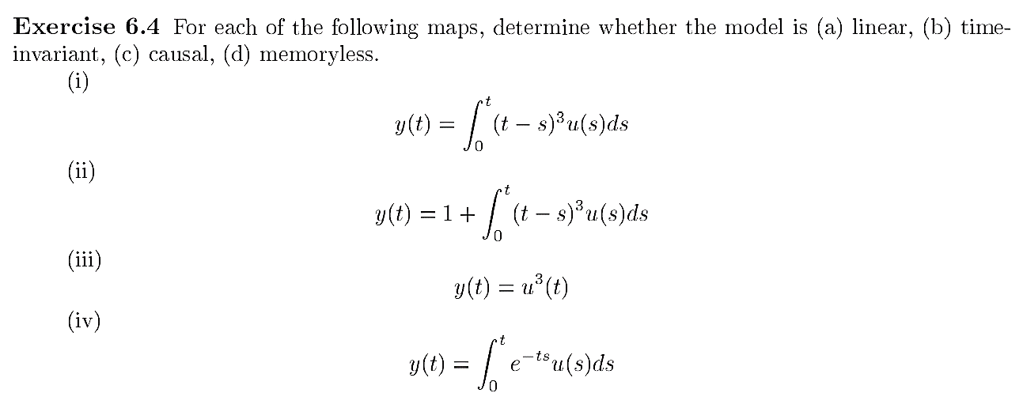
Exercise 4.

Slide 11
State Space Models

Slide 12
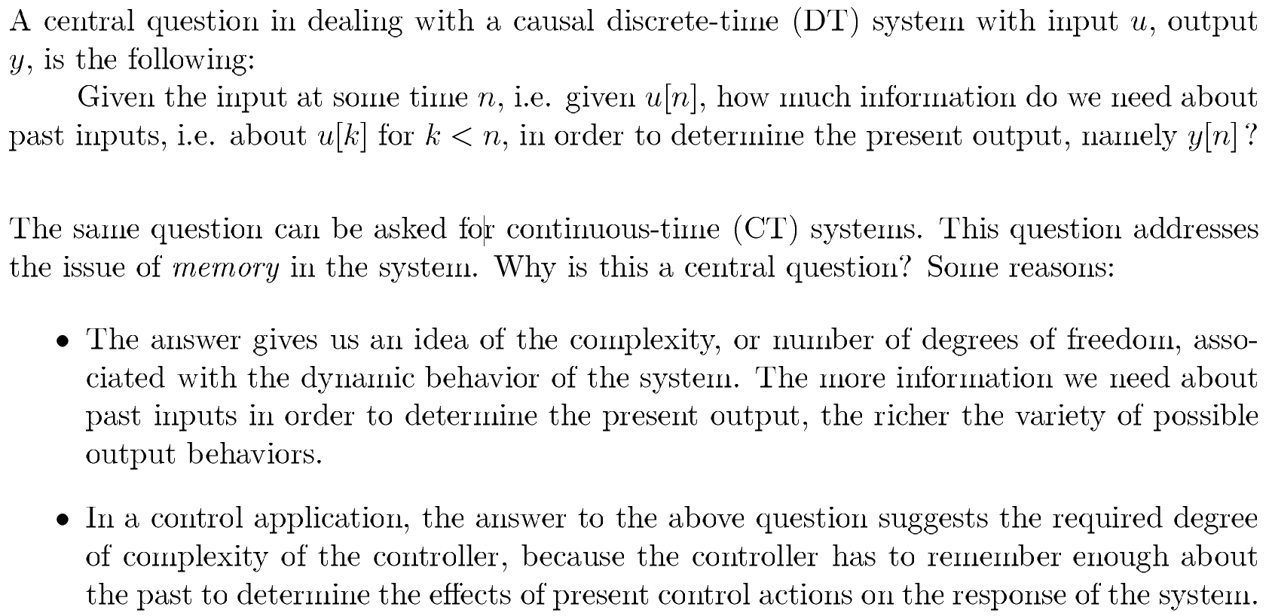
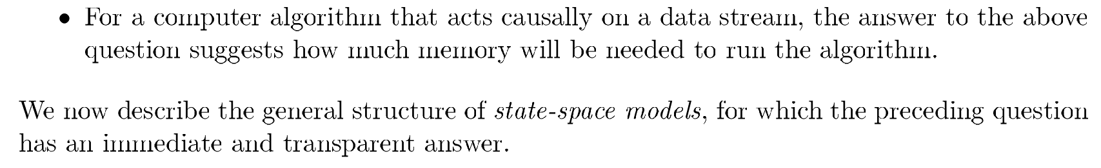

Slide 13
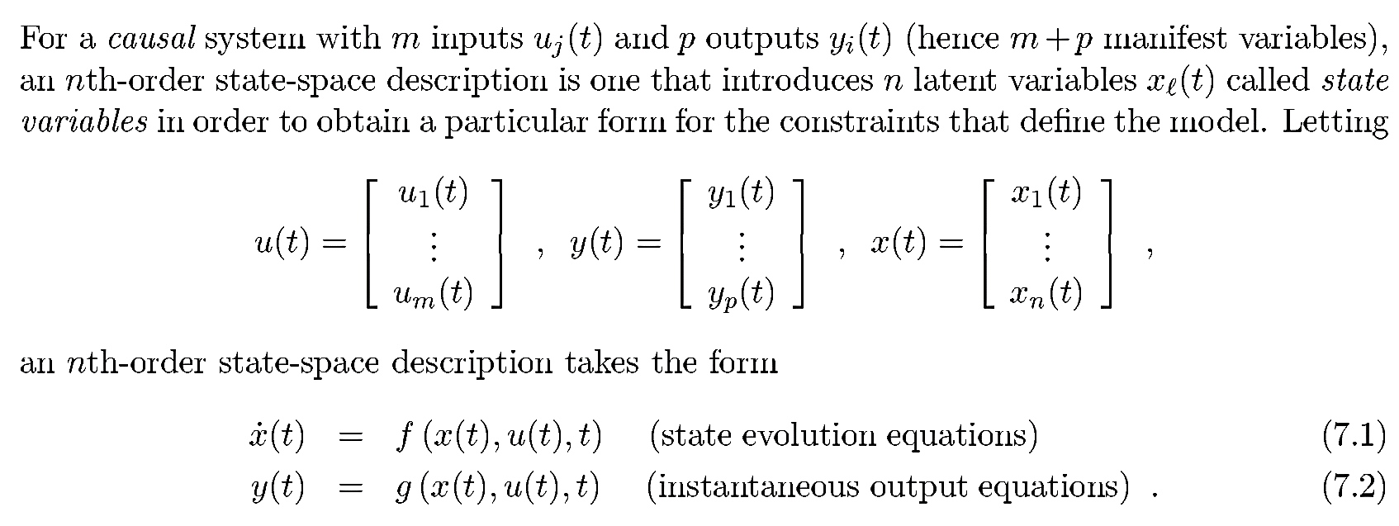
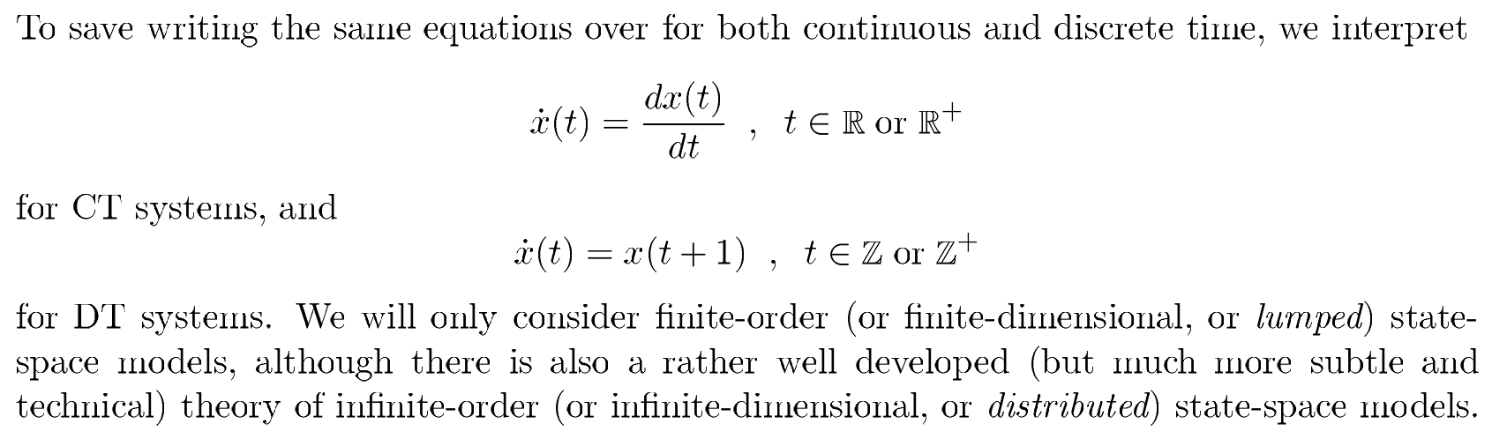


General
Description
…$(A)$
…$(B)$

Slide 14
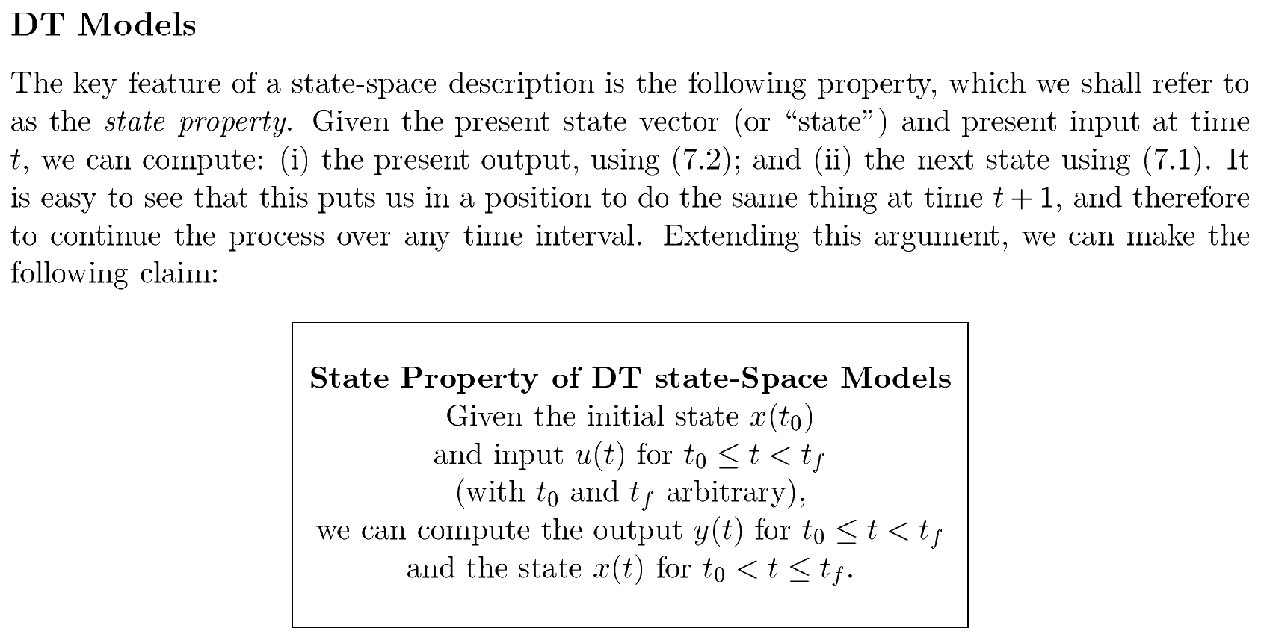
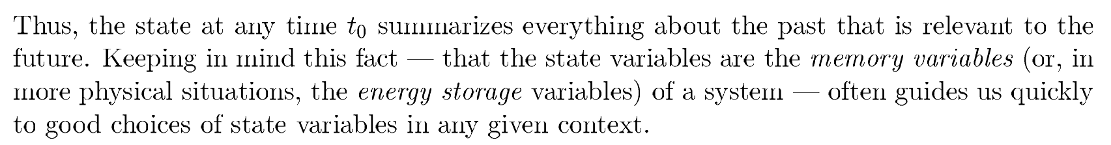


$$(B)$$
$$(A)$$

Slide 15
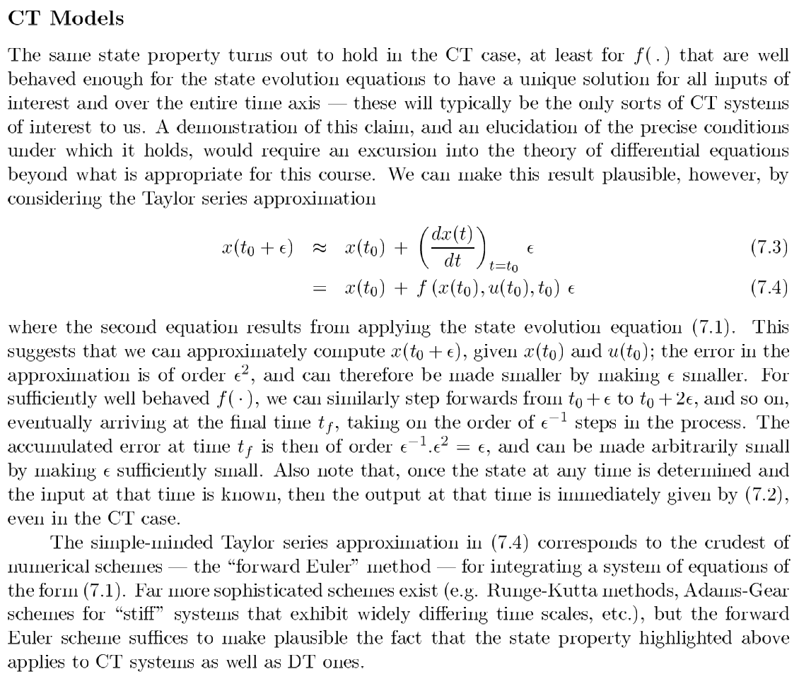





…$(C)$
…$(D)$
$$(A)$$
$$(D)$$
$$(A)$$

Slide 16
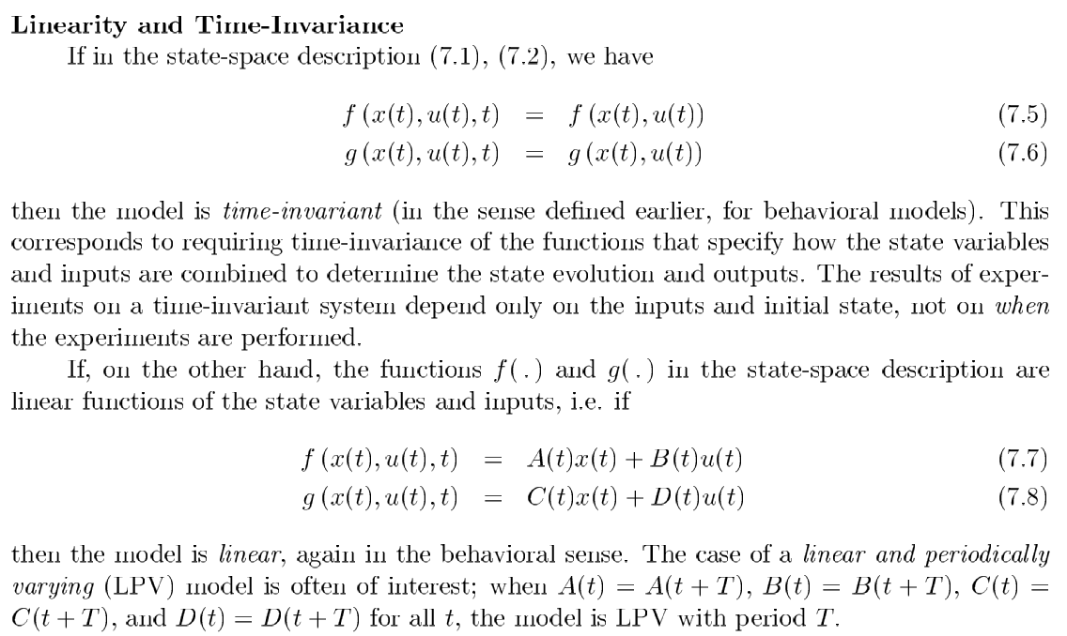






$$(A)$$
$$(B)$$
…$(E)$
…$(F)$
…$(G)$
…$(H)$

Slide 17
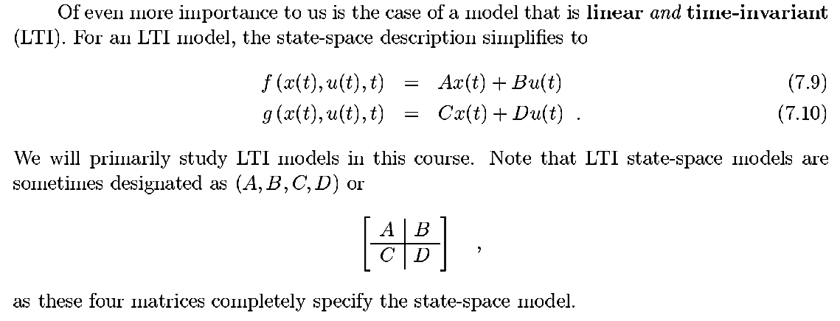


…$(I)$
…$(J)$

Slide 18
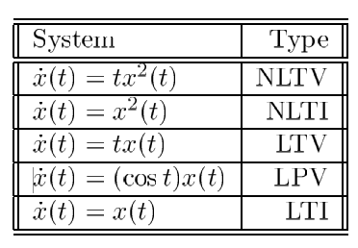
Some examples of linear, nonlinear, time-varying, periodically-varying, and time-invariant state-space descriptions.

Slide 19
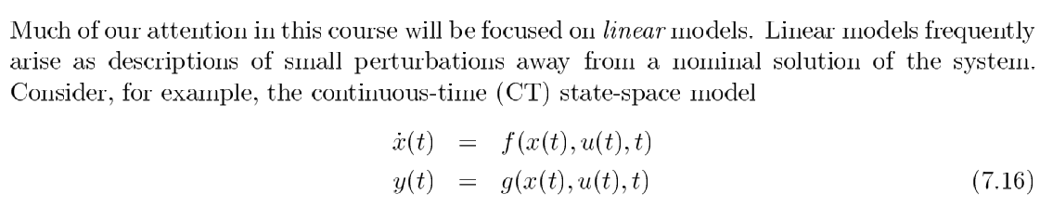
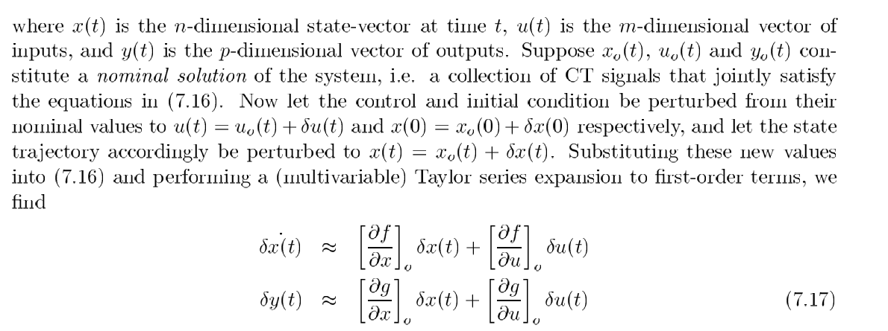
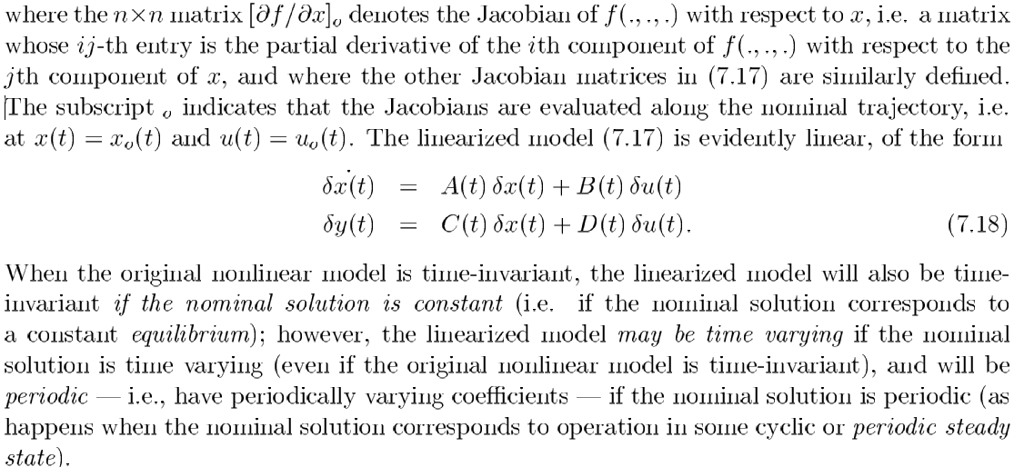






Linearization
…$(K)$
$$(K)$$
$$(K)$$
…$(L)$
$$(L)$$
$$(L)$$
…$(M)$

Slide 20
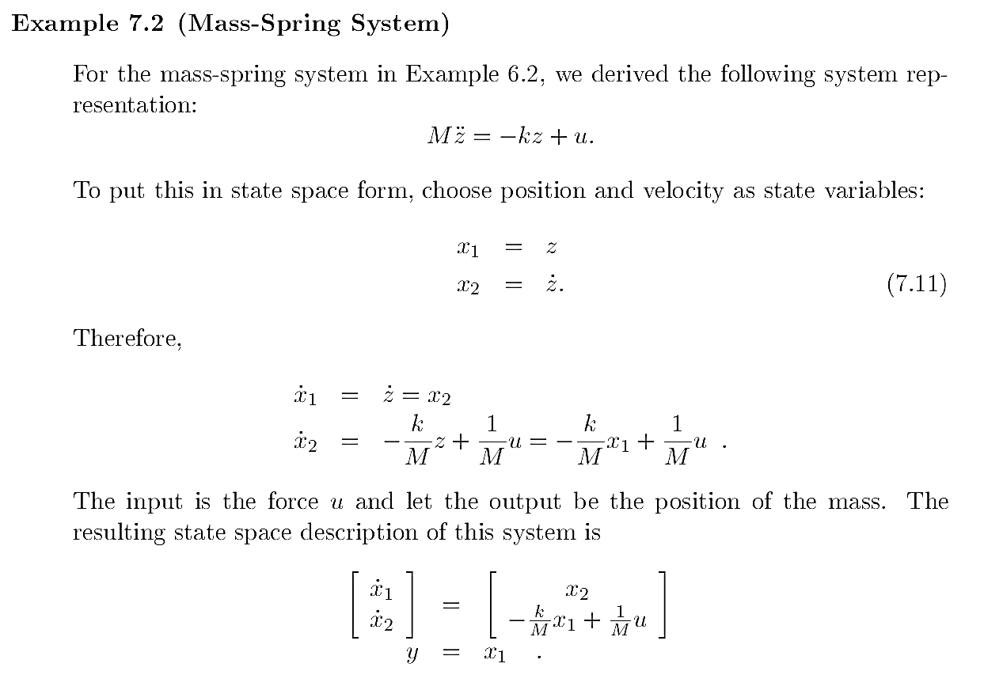
we’ve have had,

Slide 21
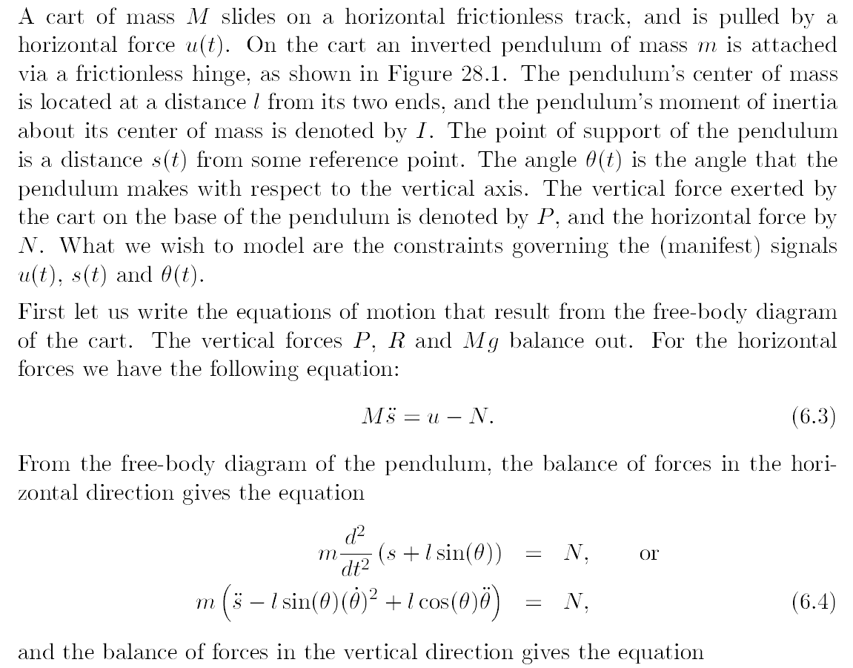
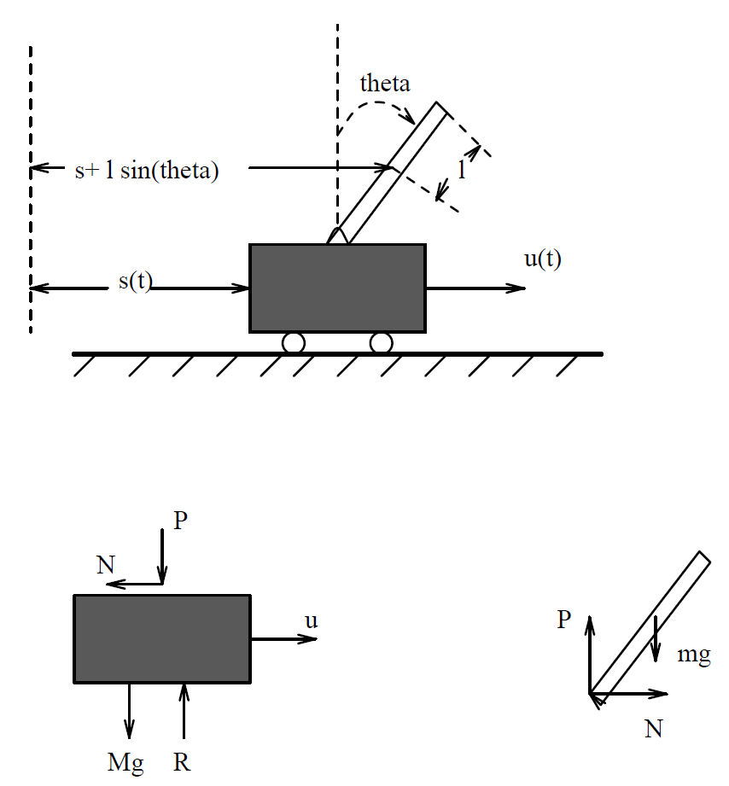


the figure.
$$…(A)$$
$$…(B)$$

Slide 22
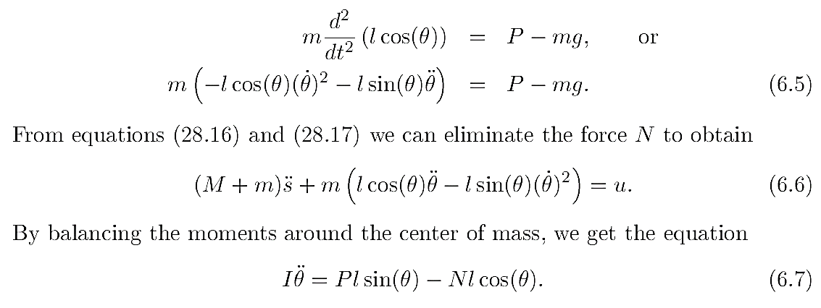
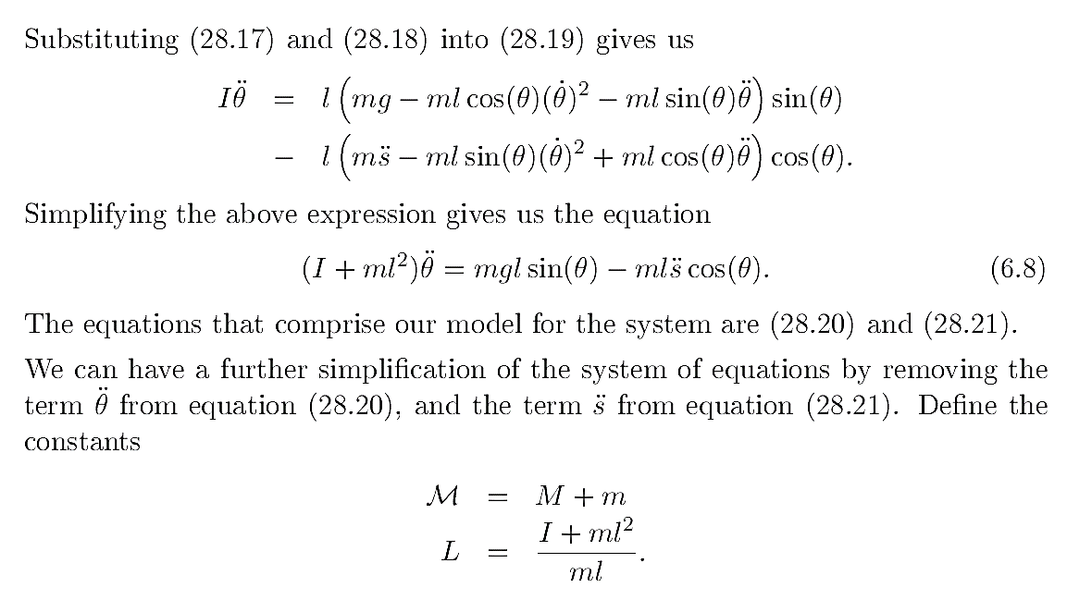













$$…(C)$$
$$(A)$$
$$(B)$$
$$…(1)$$
$$…(D)$$
$$(B)$$
$$(C)$$
$$(D)$$
$$…(2)$$
$$(1)$$
$$(2)$$
$$(2)$$
$$(1)$$
and simplify

